Slide 1

Wahlinformationssystem
Dhia Bouassida
Omar Bouattour
05.02.2024

Slide 2



1. Architecture
React Frontend:
Analysis Page
Voting Page
FastAPI Backend:
Provides RestAPI endpoints
Logic Layer
PostgreSQL:
Relational Database Management System
Stores Election Data

Slide 3
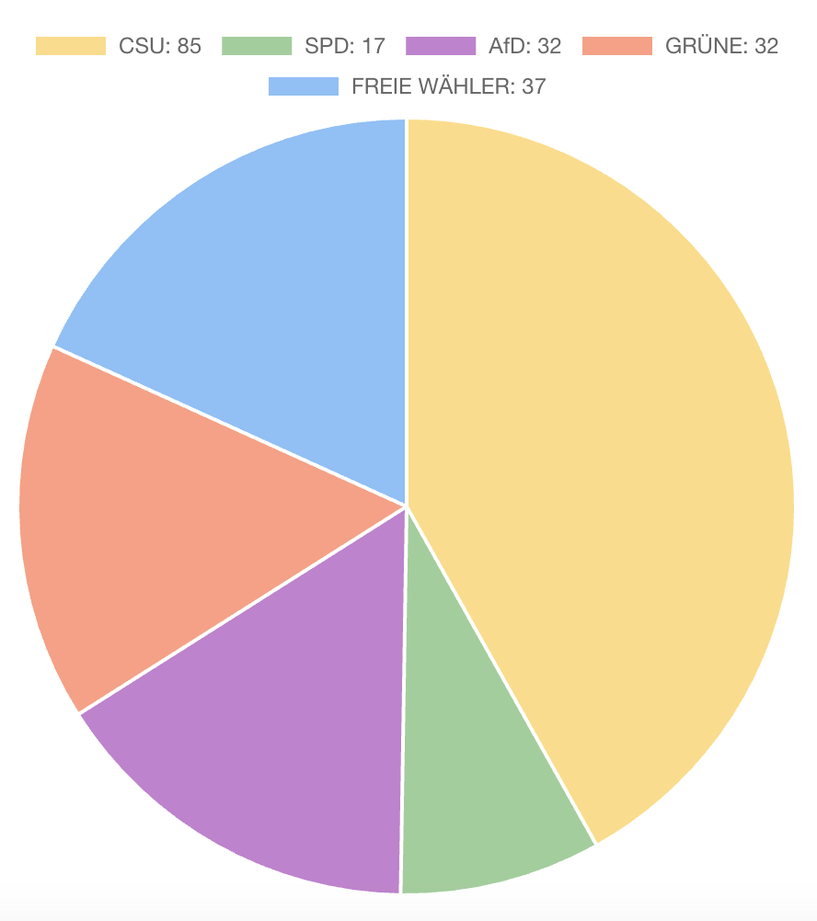
2. Seat Allocation: The Sainte-Laguë Method
The Sainte-Laguë Method: Iterative algorithm ensuring proportional representation in elections.
Initial Allocation: Seats are initially allocated based on party votes divided by a calculated divisor.
Adjusting the Divisor: If the total allocated seats does not match the available seats, the divisor is adjusted:
If too many seats: The divisor is recalculated as the average of the two smallest values of party votes divided by (rounded allocation minus 0.5).
If too few seats: The divisor is recalculated as the average of the two largest values of party votes divided by (rounded allocation plus 0.5).
Final Allocation: The process repeats until the number of allocated seats equals the total seats available.
Special Rule: If a party's direct votes exceed its initially allocated seats, the divisor is recalculated to ensure they receive at least as many seats as direct votes.

Slide 4
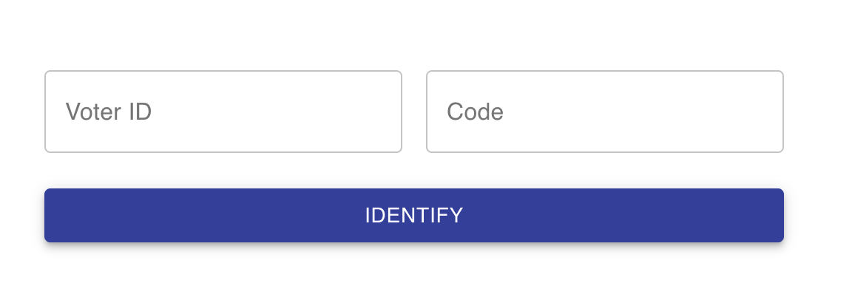
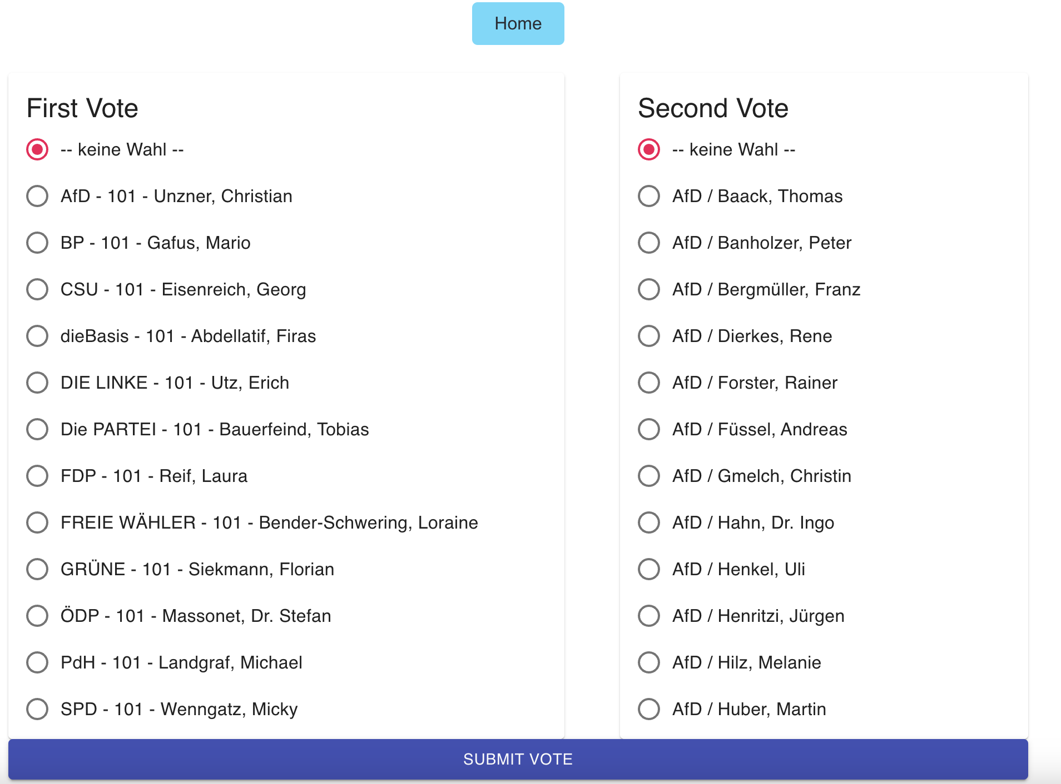
3. Voting
Secure, anonymous digital voting system with a token-based mechanism.
During Registration:
Voters register using their national ID and Stimmkreis (electoral district), which is used to generate a unique voting token.
The system checks for double registration in any Stimmkreis to prevent duplicate entries.
During voting:
Voter enters their ID and Stimmkreis
Server responds with their unique token and corresponding Erststimmzettel and Zweitstimmzettel.
Voter choses their Vote
Vote is sent with the unique token to the server -> anonymous vote
After successful submission, the token is invalidated to prevent reuse.

Slide 5
4. Benchmarks

Slide 6
4. Demo

